Slide 1

Final project
Jeodyshan Obra

Slide 2
IS 362 Final project
For this project I used the data source from NYC Open Data. However, instead of using the traditional csv like what we did most of the time. I decided to try and use an API from NYC Open Data
I had to sign up and request an API key
After receiving the key I had to read the document onto how to call the API using Python and it requires using Socratas and sodapy

Slide 3
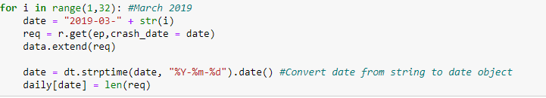
Calling the dates
Now that we can access the API, we can now request data.
I then wanted to request data by getting data from March & April 2019 and compare it with March & April 2020.
I used a for loop to find the range for the months I need. In this case March & April.
I then converted the date and transformed it to a date object.

Slide 4
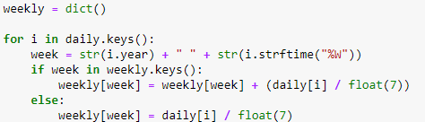
Finding the average
Now that we have the dates, we should now use the data and calculate the Average Weekly Collisions.
In the code below I used a dictionary to find the average for each week

Slide 5
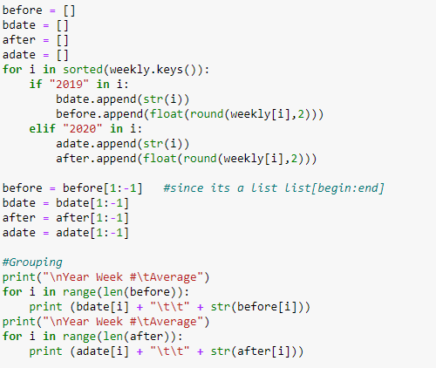
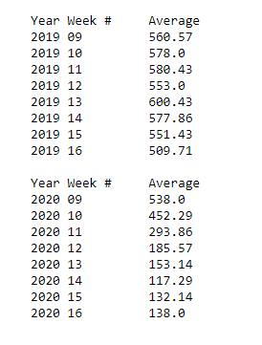
Printing results
After finding the Average Weekly Collisions of both March & April I created an array for the results and grouped the results with weeks. Shown Below

Slide 6
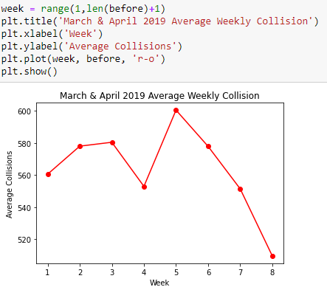
March & April 2019 Data
Here is a line graph of March & April 2019

Slide 7
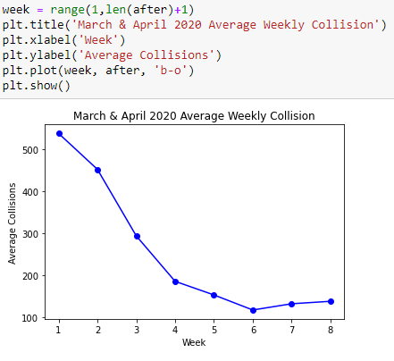
March & April 2020
Here is the data for March & April 2020

Slide 8
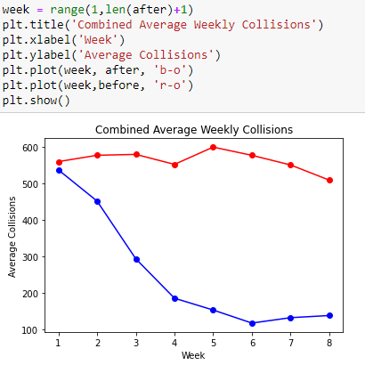
Compare 2019 & 2020
Here is the line graph of both 2019 and 2020

Slide 9
Conclusion
Based on the data, it seems that 2019 was just a stable line when it comes to Average Weekly Vehicle Collisions.
When COVID-19 created the lockdown for NYC I would assume that car accidents would significantly reduce. Since everyone was to follow stay-at-home orders.
Based on the data shown the first few weeks of March 2020 was the same then before April 2020 it created a significant drop proving my point.

